Slide 1

2024 DSEATS DATATHON
A MACHINE LEARNING WORKFLOW FOR MULTIVARIATE PRODUCTION FORECASTING OF OIL AND GAS WELLS USING THE DSEAT FIELD DATA WITH WEB-BASED IMPLEMENTATION.
13th July, 2024
Shedrach Igemhokhai, 5056696
SPE Benin section (Section 116)
Student, Dept. of Petroleum Engineering,
University of Benin.

Slide 2
OUTLINE
Introduction
Data Preparation
Exploratory Data Analysis (EDA)
Feature Engineering
Machine Learning Workflow
Web App Development
Conclusion and Future Work
Results
1
2
3
4
5
6
7
8

Slide 3
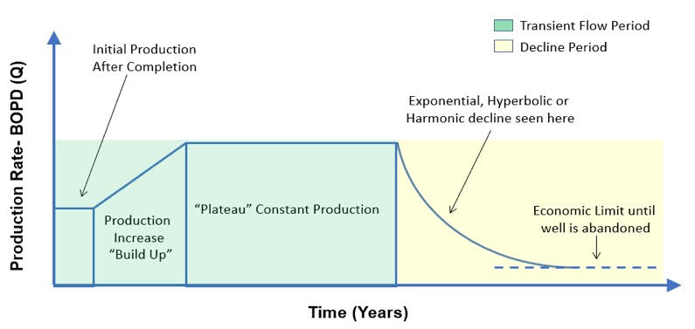
INTRODUCTION
Production Forecasting involves predicting future production rates of oil, gas and water from reservoirs.
It is crucial for economics planning, investment decisions, reservoir management, and operational efficiency.
Traditional methods of production forecasting uses Decline Curve Analysis (Fig 1) and Material Balance, but this often assumes constant reservoir conditions and lacks flexibility.
Machine Learning can address this challenge by providing data-driven insights, adaptability to changing reservoir conditions and more accurate forecasts.
Combining ML with IoT and real-time data monitoring can enhance accuracy and efficiency.
Fig 1: A typical illustration of an oil and gas Decline Curve
INPUT PARAMETERS
Utilize DSEAT field data to develop a stacked model for predicting oil, gas and water production rate.
METHODOLOGY
Implement best ML practices and evaluation techniques in obtaining best performing model
PERFORMANCE
Develop an effective generalizable model
WEB APP DEVELOPMENT
Develop a web app that implements workflow on new field data
Project Objectives

Slide 4
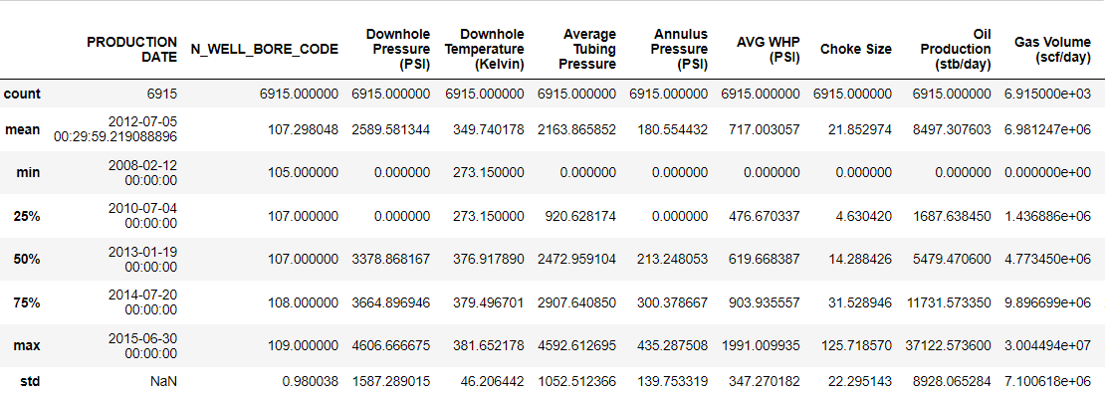
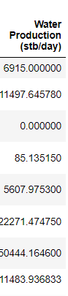
DATA PREPARATION
EXPLORATORY DATA ANALYSIS
The production data utilised in this project was acquired from the DSEATS field
For the dataset to be made suitable for use, it first needs to be cleaned
Missing values were removed, following standard machine learning practises
Upon inspection of the data, it contained negative production values. As this is not practically feasible, this very few roles were dropped
The data type was formatted, to ensure it is suitable for analysis and modelling
The DSEAT field contains a number of five different wells: DSEAT-001-F-12 H, DSEAT-001-F-14 H, DSEAT-001-F-11 H, DSEAT-001-F-15 D, and DSEAT-001-F-1 C , with production from 2008 to 2015
It consist of features ranging from date of production, average wellhead pressure to the produced reservoir fluids.
Fig 2: Summary Statistics of historical data after cleaning procedures

Slide 5
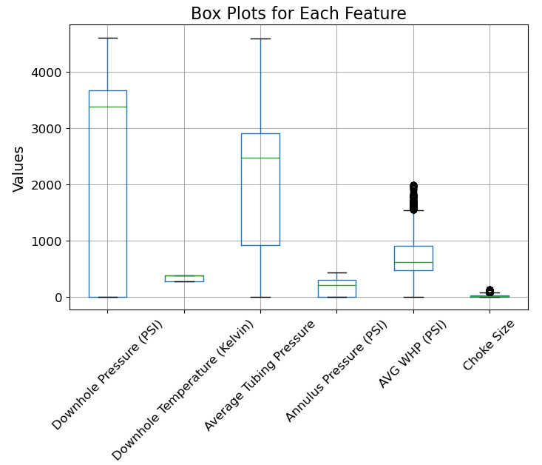
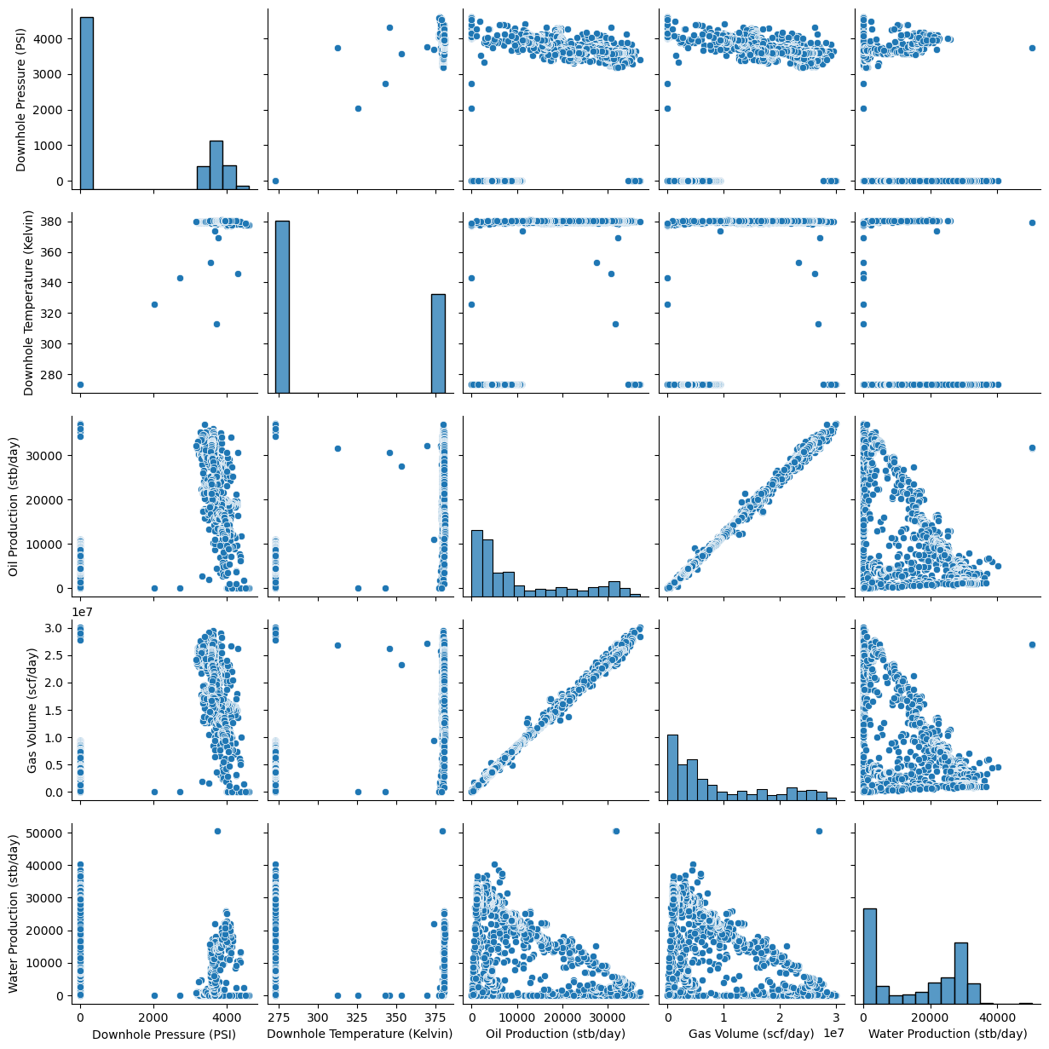
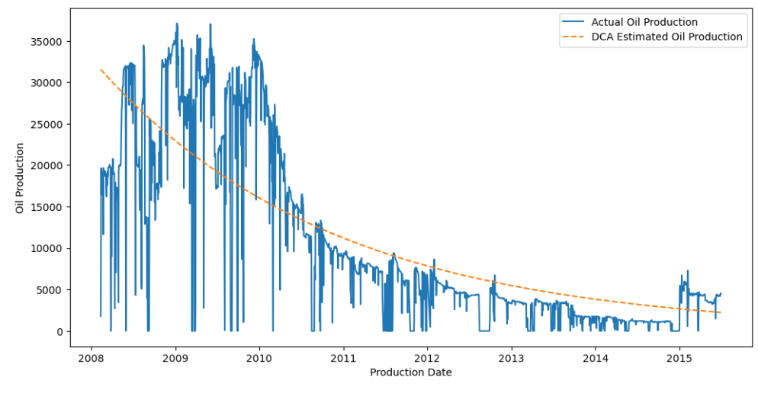
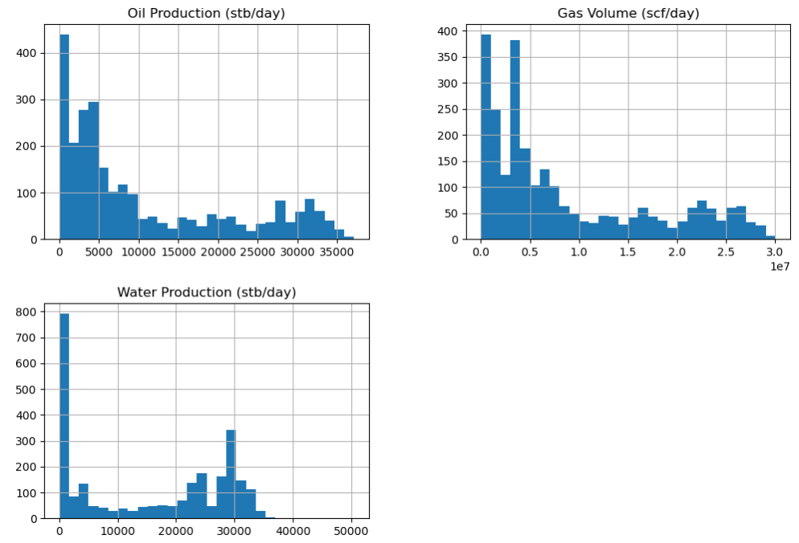
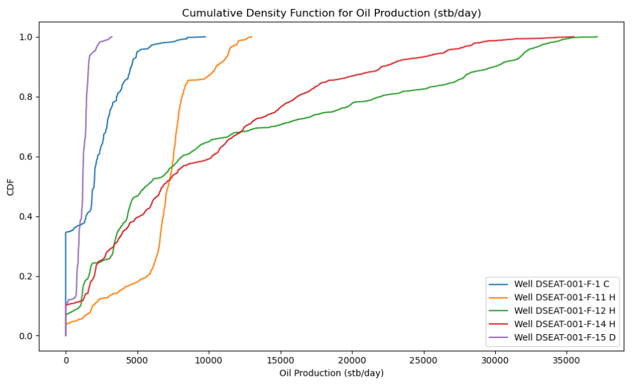
EXPLORATORY DATA ANALYSIS - CONTD
Fig 5: Oil production decline curve for well DSEAT-001-F-12 H
Fig 3: Box plot of initial input features showing their distribution
Fig 6: Oil production Cumulative density function plot for the different wells
Fig 7: Pairplot showing relationship between input features
Fig 4: Distribution plot of target features for well DSEAT-001-F-12 H

Slide 6
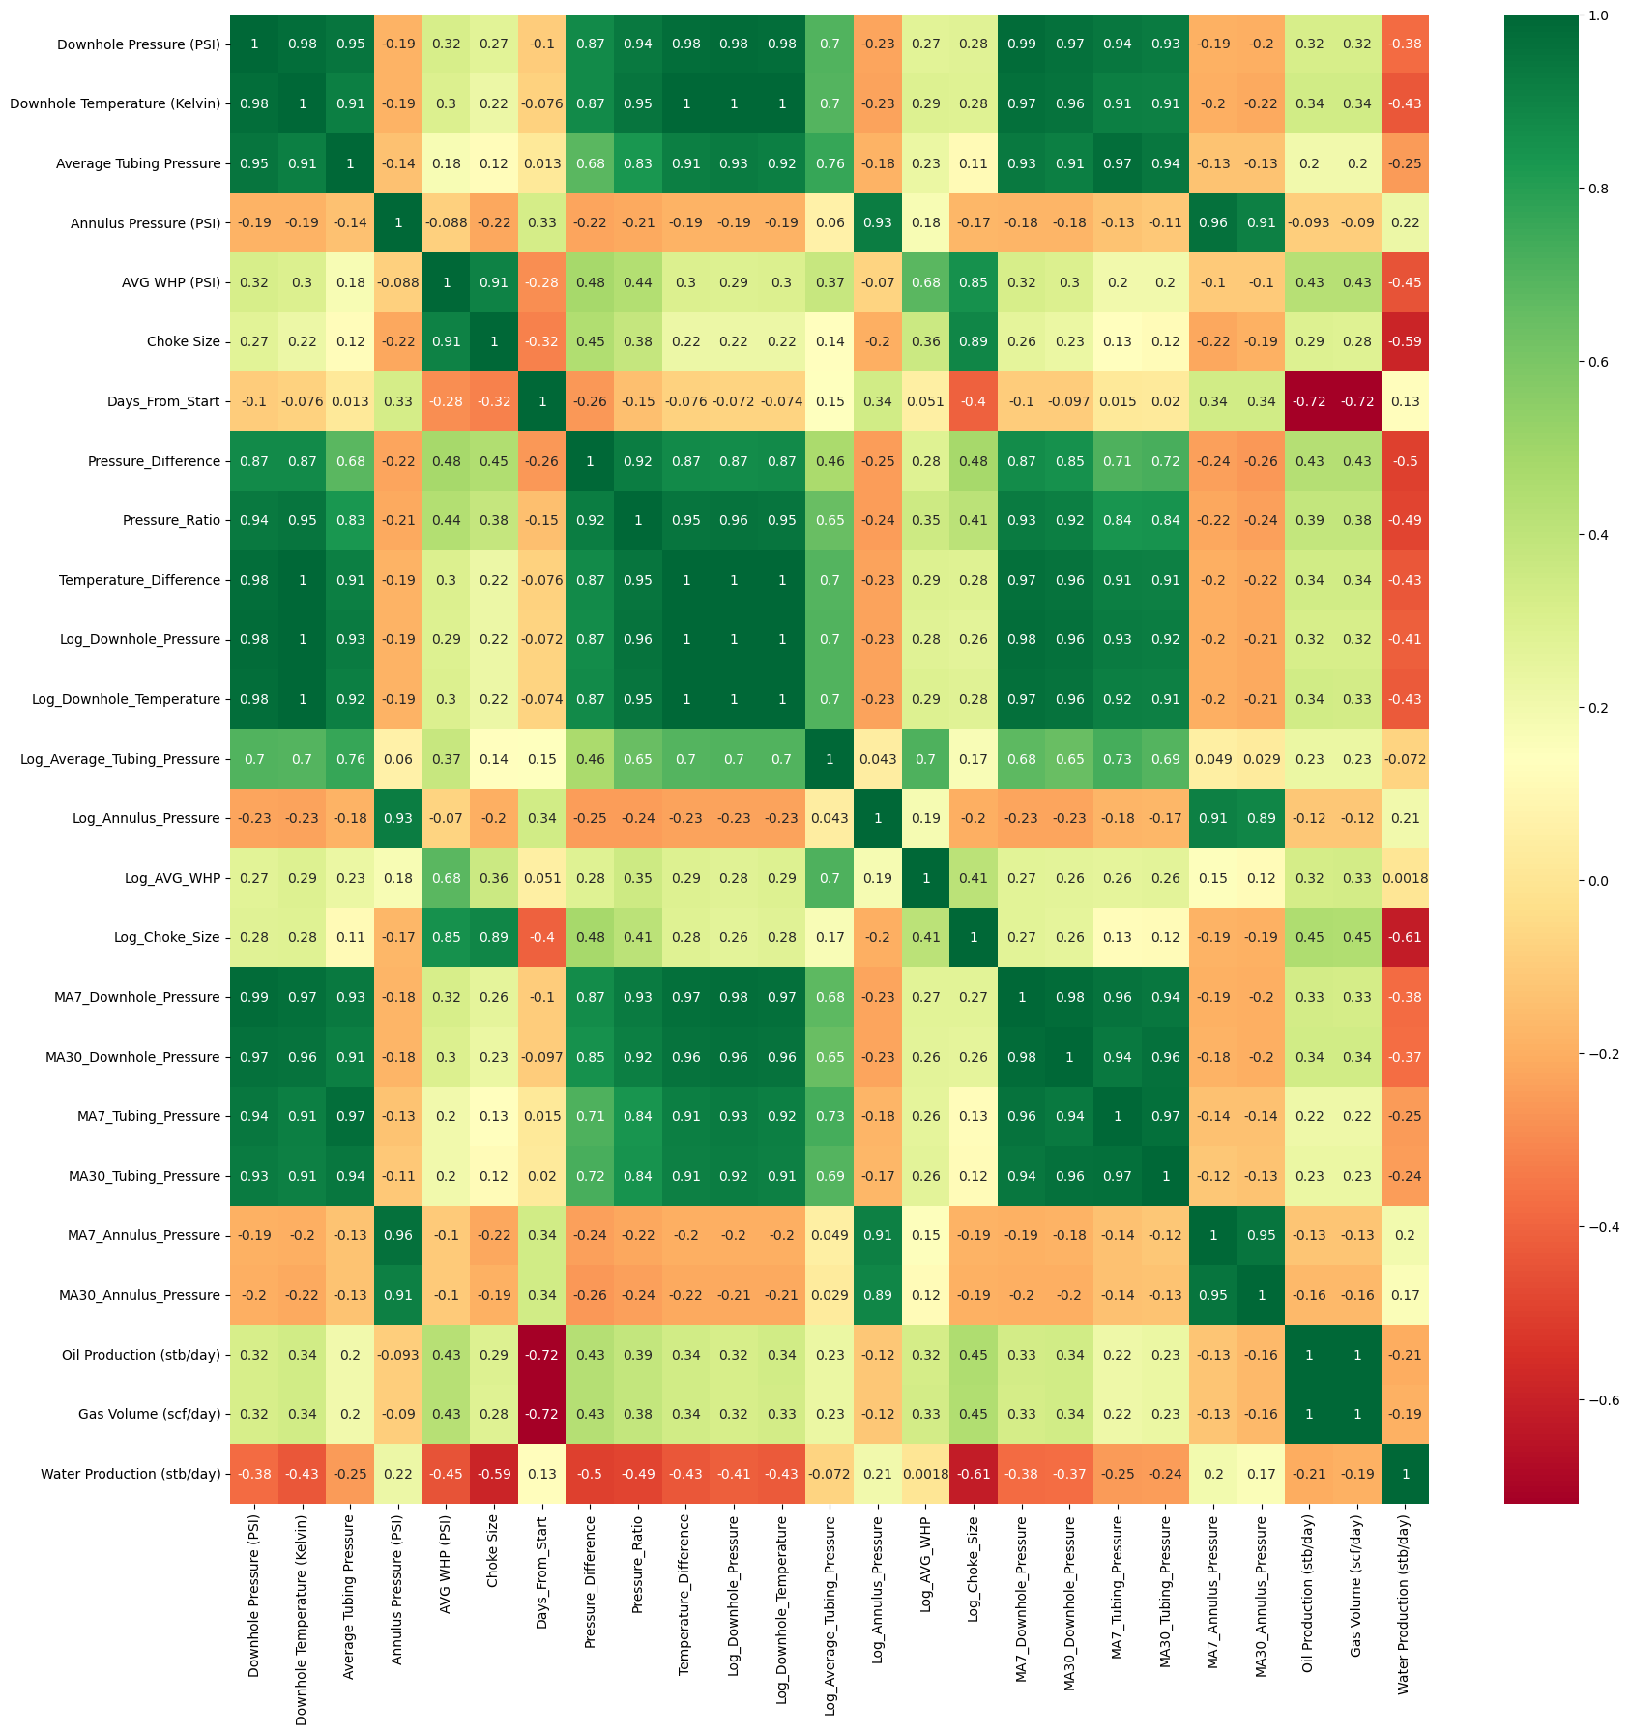
FEATURE ENGINEERING
An effective Machine learning model, depends significantly on the features utilized for training.
For most ML work, it is sometimes imperative to create new features that improves the effectiveness of the given models.
These features are often based on standard ML practises and domain knowledge
The Pearson correlation heat map below in Fig 8 shows the relationship between the input features and the Targets.
The Engineered features show good relationship with the target. For instance, Days_From_Start show a high correlation of -0.72 with both oil and gas production rate.
Initial Features
Engineered Features
Targets
Fig 8: Pearson correlation coefficients between input and output parameters

Slide 7
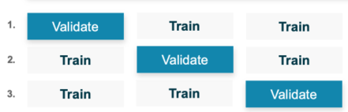
MACHINE LEARNING WORKFLOW
The Workflow implemented in this project is shows in the process flow sideways.
The inputs are :
Average Wellhead Pressure(WHP)
Downhole Pressure (DHP)
Downhole Temperature (DHT)
Average Tubing Pressure (ATP)
Annulus Pressure (AP)
Choke Size (CS)
For all models, a Multi-Output approach was implemented, using a MutiOutputRegressor, whereby the individual models were trained and used to predict the production rates simultaneously.
Input
Pre-processing
CV Strategies
Feature Scaling
Machine Learning
Output
WHP
DHP
DHT
ATP
AP
CS
Remove null values and dropped neg production values
Format Data types
Feature Engineering
Grid Search
Cross Validation
Standard Scaling of data for non tree-based models
Initialise Model
Optimise Model
Validate Model
Test Model
Forecasting
Oil Rate
Gas Rate
Water Rate
Training and Test Splitting
Split data into 3 folds
Linear Regression
Kernel ridge regression
Random Forest
Xgboost
Gradient Boosting
Extra Trees
AdaBoost
MLP
3 Fold Cross Validation
Training
Test
80%
20%
Base Models
The best performing models were stacked together (fig 9) to form a meta-model. This meta-model has the advantage of generalization and reducing overfitting to the barest minimum.
Random Forest
Meta Model
Oil Rate
Data
XGboost
Linear Regression
Final Predictions
Gas Rate
Extra Trees
Water Rate
Gradient Boost
Fig 9: Stacked model implementation

Slide 8
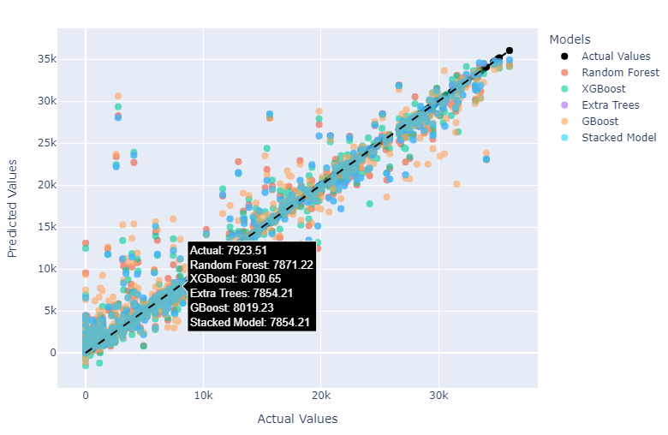
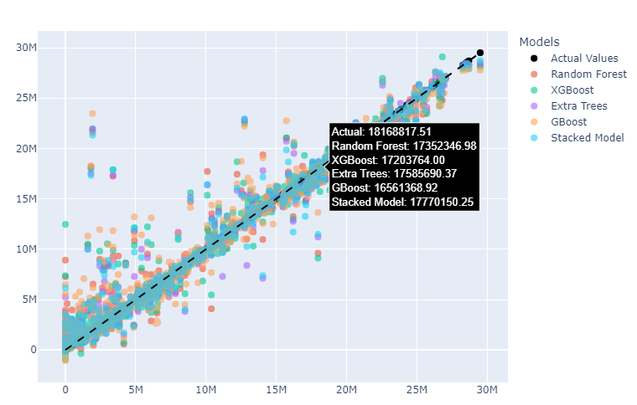
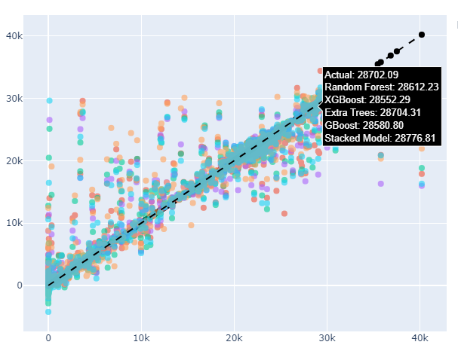
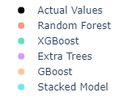
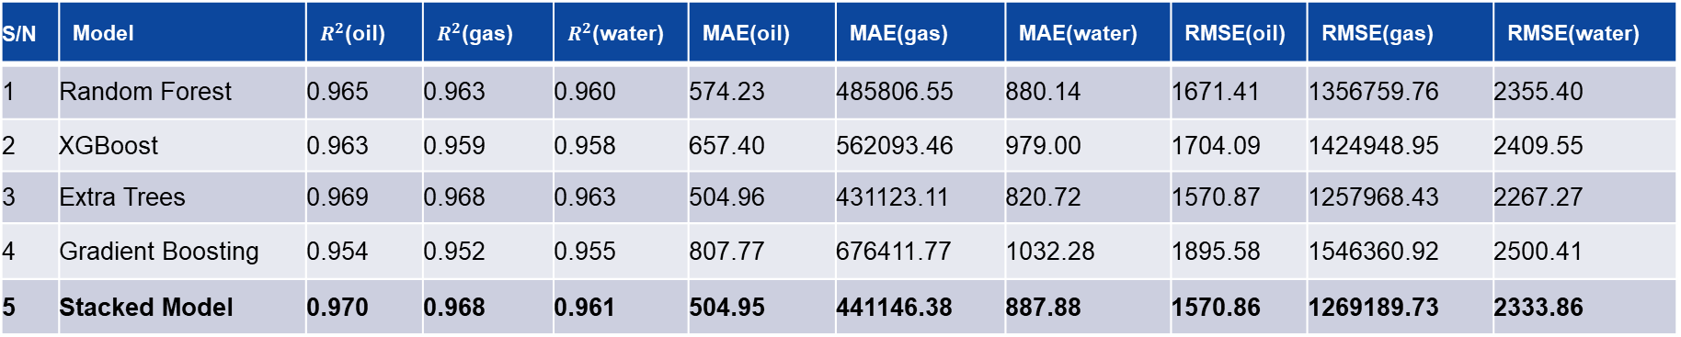
RESULTS
Performance Evaluation of the five best models utilized in the workflow
S/N | Model | $R^{2}$(oil) | $R^{2}$(gas) | $R^{2}$(water) | MAE(oil) | MAE(gas) | MAE(water) | RMSE(oil) | RMSE(gas) | RMSE(water)
1 | Random Forest | 0.965 | 0.963 | 0.960 | 574.23 | 485806.55 | 880.14 | 1671.41 | 1356759.76 | 2355.40
2 | XGBoost | 0.963 | 0.959 | 0.958 | 657.40 | 562093.46 | 979.00 | 1704.09 | 1424948.95 | 2409.55
3 | Extra Trees | 0.969 | 0.968 | 0.963 | 504.96 | 431123.11 | 820.72 | 1570.87 | 1257968.43 | 2267.27
4 | Gradient Boosting | 0.954 | 0.952 | 0.955 | 807.77 | 676411.77 | 1032.28 | 1895.58 | 1546360.92 | 2500.41
5 | Stacked Model | 0.970 | 0.968 | 0.961 | 504.95 | 441146.38 | 887.88 | 1570.86 | 1269189.73 | 2333.86
Predicted oil rate
Predicted gas rate
Predicted water rate
Actual oil rate
Actual gas rate
Actual water rate
Fig 10: oil rate predicted vs actual values
Fig 11: gas rate predicted vs actual values
Fig 12: water rate predicted vs actual values

Slide 9
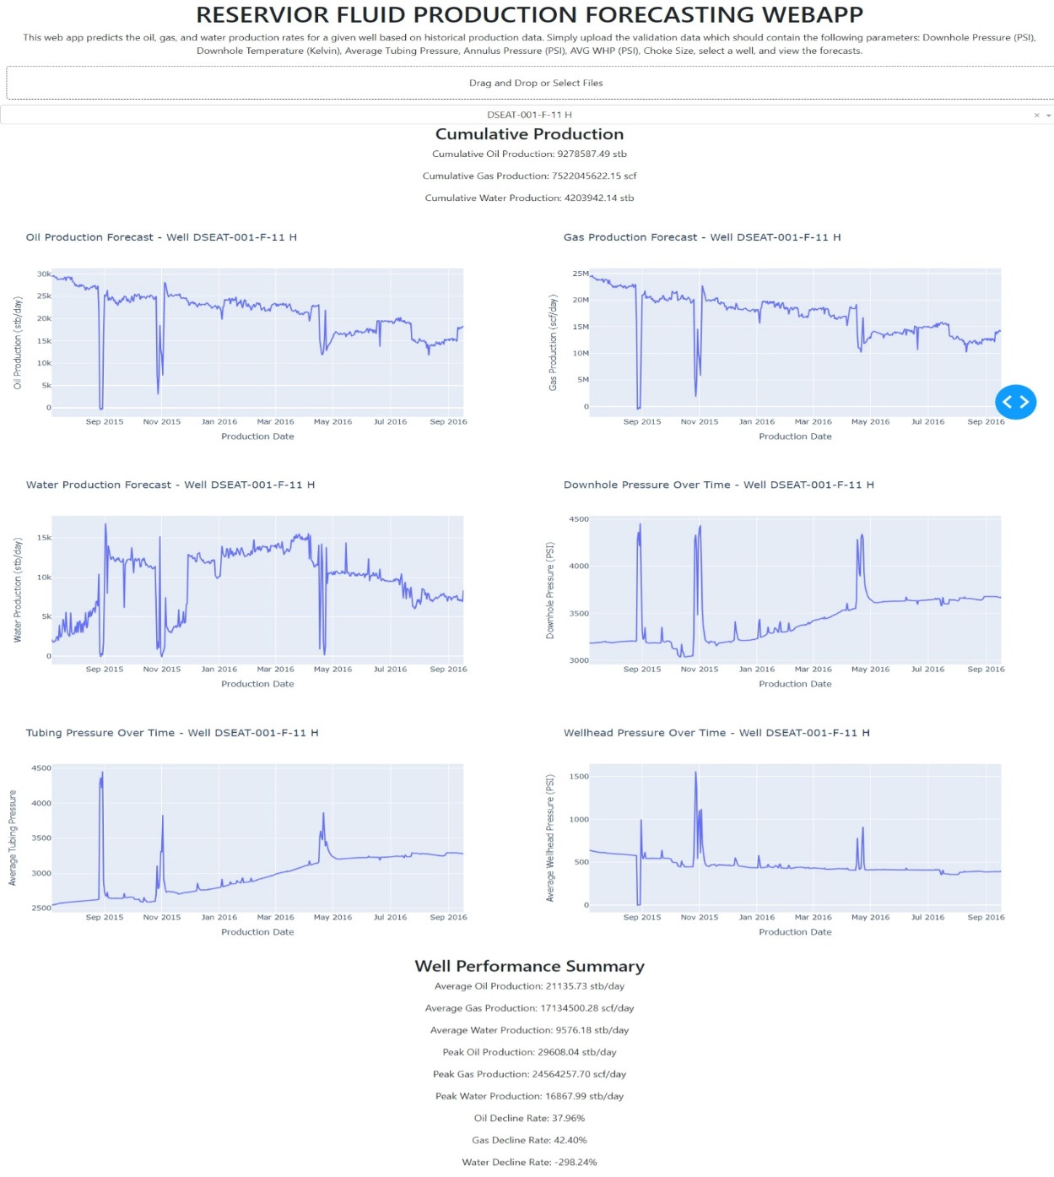
WEB APP DEVELOPMENT
RESULTS - CONTD
Total Production Estimation
 | OIL (STB) | GAS (SCF) | WATER (STB)
HISTORY PERIOD | 58,896,759.06 | 48,411,804,354.70 | 79,757,652.20
FORECAST PERIOD | 28,236,170.49 | 24,468,848,461.62 | 20,244,097.03
TOTAL | 87,132,929.55 | 72,880,652,816.32 | 100,001,749.23
Web app Development
For the Final Part of this project, The Machine Workflow was deployed in a local based-web app (fig 13). This web app would take the input data, and Perform the necessary data cleaning and feature engineering procedures and ultimately return the production forecasts and other valuable insights from the data.
Fig 13: Developed web app

Slide 10
CONCLUSION AND FUTURE WORK
Contribution to Petroleum Industry
Possible Implementations
Limitations
The result from this work can be adopted by engineers and economic analysts for accurate forecasting of production rates
A larger dataset encompassing different field from different geologic regions would have made the ML model more robust and generalizable
This work establishes an approach for applying machine learning to practical Oil and Gas problems
Future Work
The methodology utilized can be applied to worldwide datasets to forecast reservoir production rates, and IoT can be implemented as well for real-time data monitoring and production rates forecasting
THANK YOU

